Slide 1
2D Animation LP
Feedback

Slide 2
Section Sequence
About us
Our services
Our Solutions
Why animated videos
Our Clients
Testimonials
Contact form

Slide 3
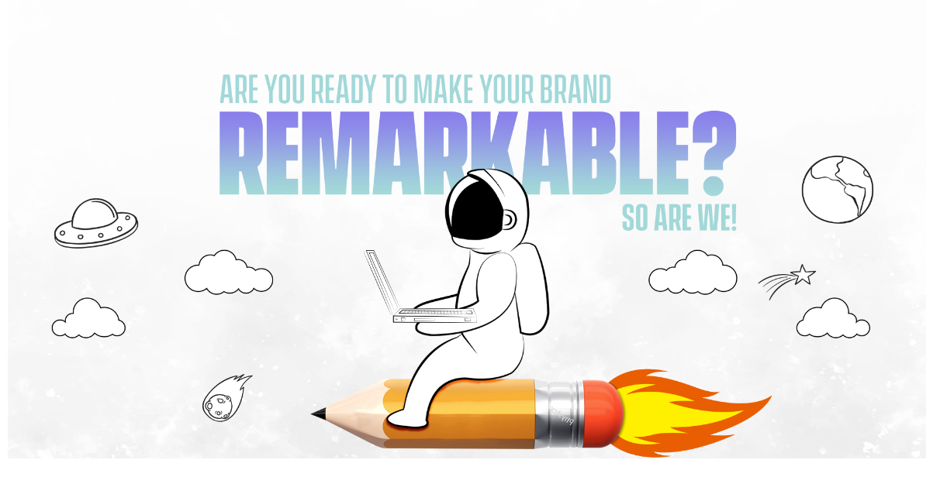
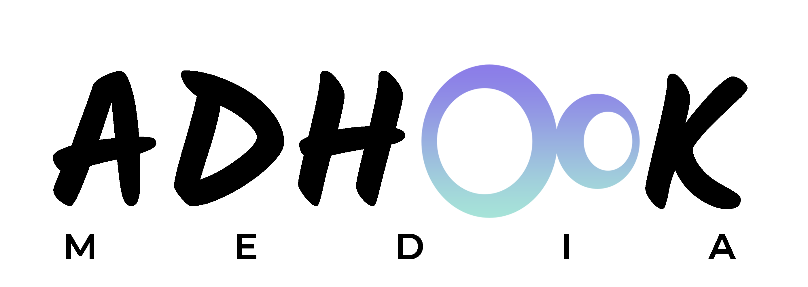
Add logo
Our Services
Why
animated videos
About us
Get in Touch
Our Solutions
Put headers in the clouds

Slide 4

Use same fonts, mentioned on the psd
Revolve this too
Just revolve the earth
Background missing at the top
Increase the size of the man & the pencil
Don’t move the man, we just need the flame moving like fire

Slide 5
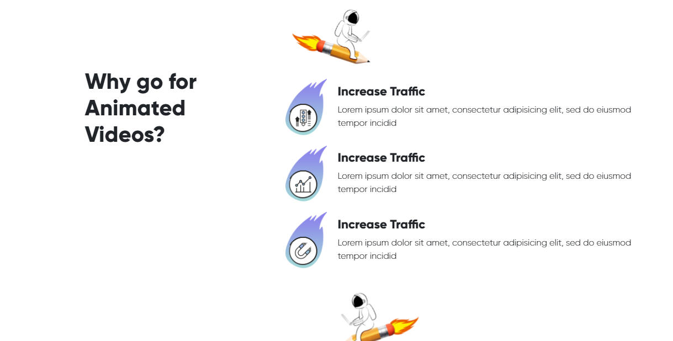
They should move on the scroll only
The fire / flame should move
The fire / flame should move

Slide 6
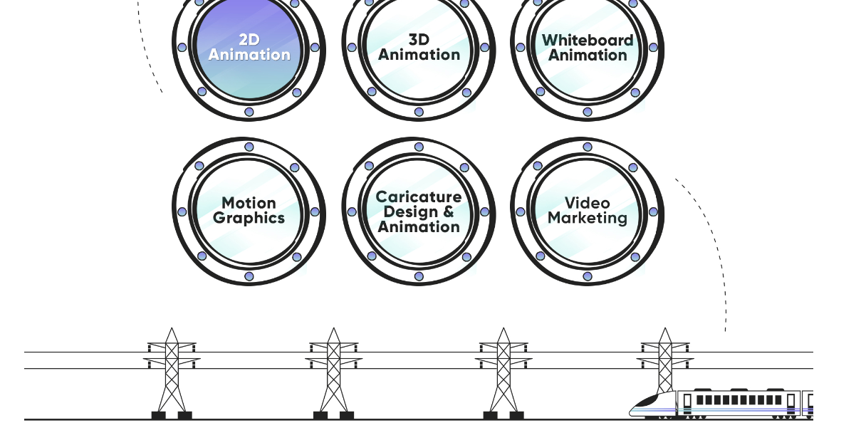
Add some space here

Slide 7
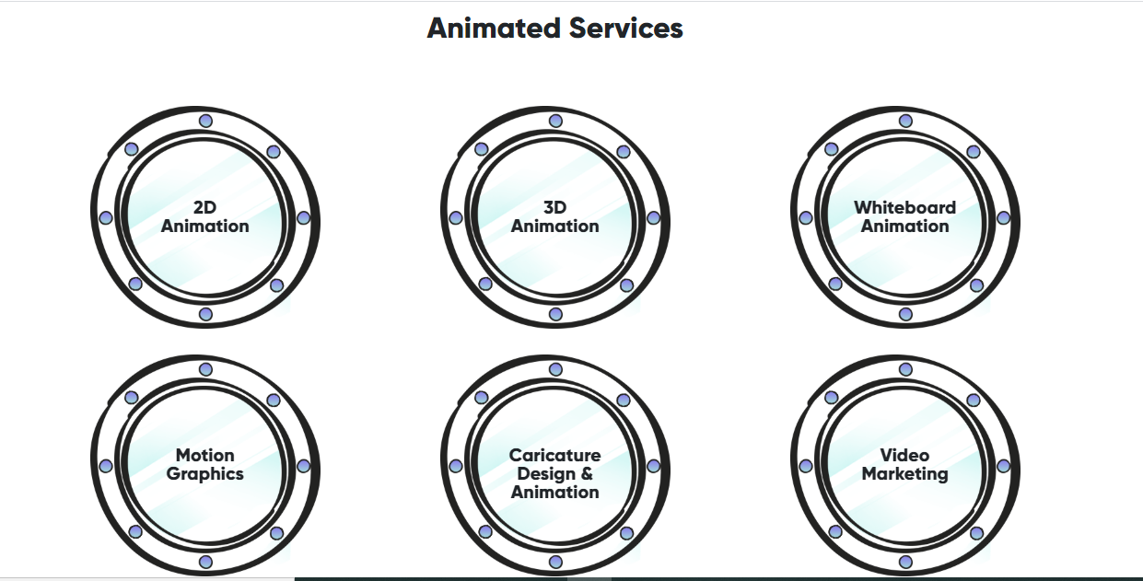
They should flip once someone hovers on them

Slide 8
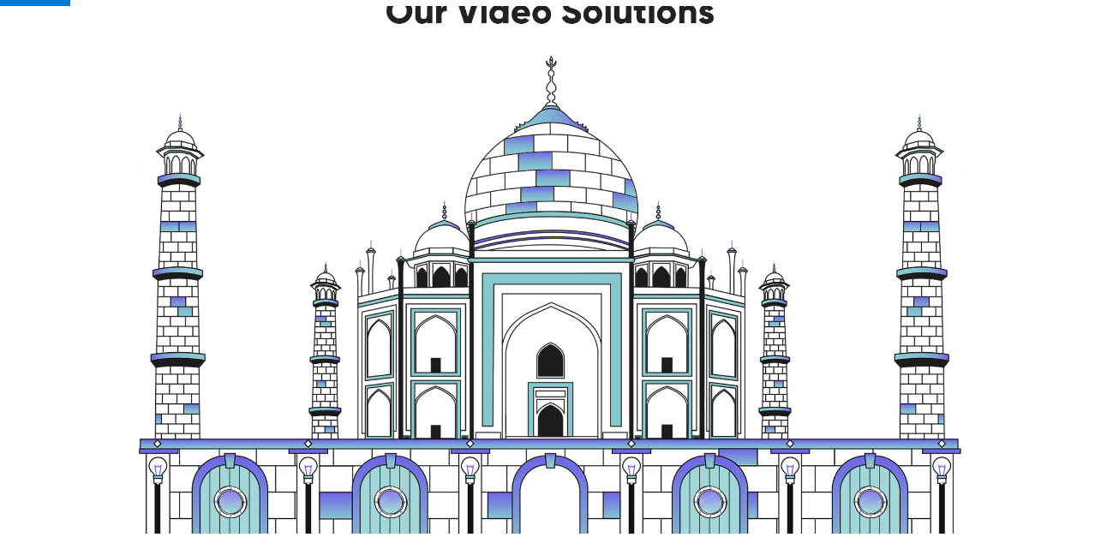
Ye thoda chota karna hoga taaki single screen me aajye, abhi ye pura section 2 scroll me ara h
They should open once someone hovers on them

Slide 9
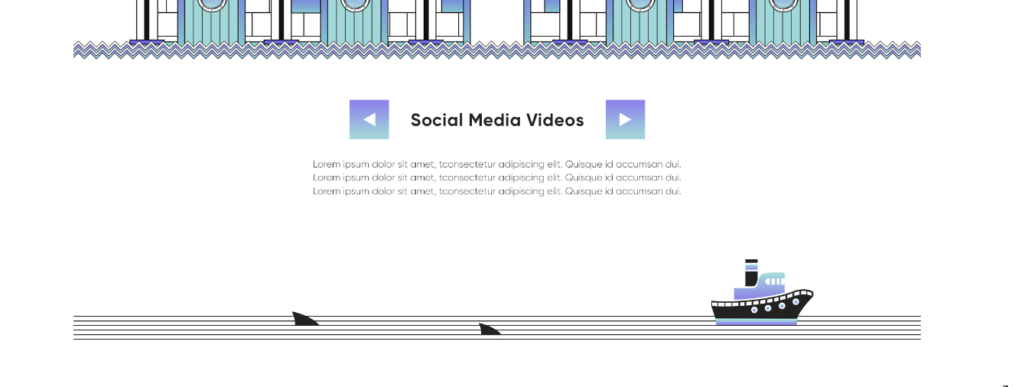
Add some space here

Slide 10
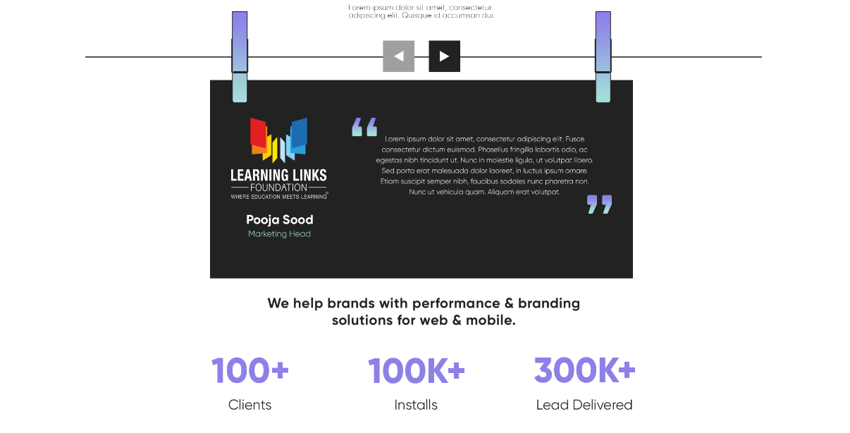
Remove this section from here & add be below about us

Slide 11
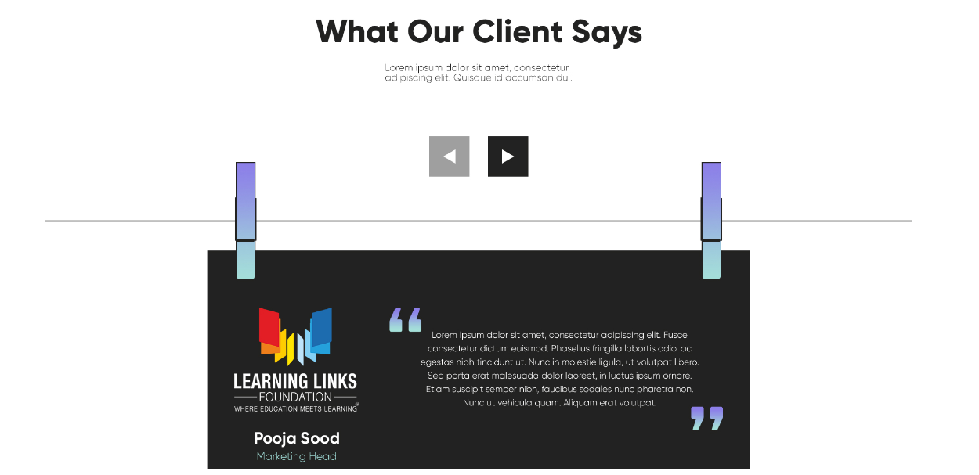
Page thoda lengthy hora h, let’s reduce some space in this section
Also single frame me pura section dikhna chahiye

Slide 12
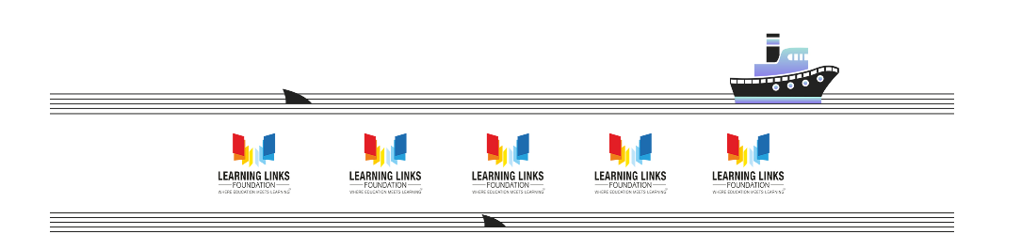
Write – Our clients
Our Clients

Slide 13
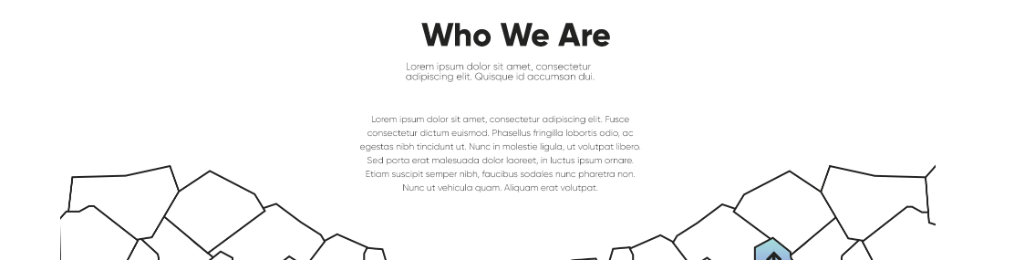

About is section – Take it to the top
Add this here

Slide 14
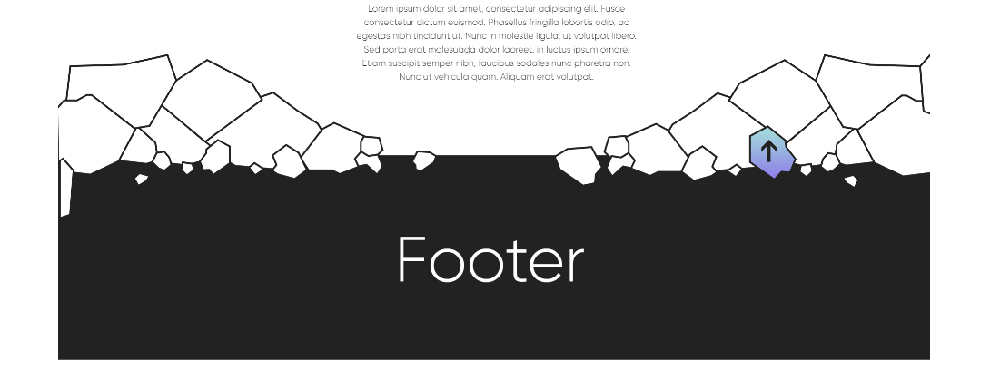

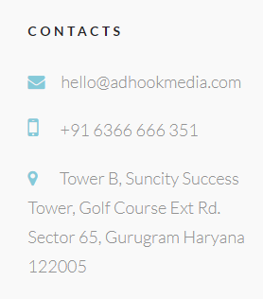
Our Videos Solutions
Animated Ads
Explainer Videos
Product Videos
Social Media Videos
E-learning Videos
Animation Services
2D Animation
3D Animation
Whiteboard Animation
Motion Graphics
Caricature Design & Animation
AdHook is a full-service digital marketing agency. We are a team of strategists, storytellers, designers, influencers, curators, technologists, data scientists, lawyers, accountants, and producers working together to acquire, retain and grow a love for brands and start-ups.

